Slide 1


Plant Disease Detection Mobile Application
Team BroCoders

Slide 2
What our Project is about?
The agricultural sector, a cornerstone of human sustenance and economic stability, plays a pivotal role in shaping societies and shaping global economies. In an era characterized by population growth, climate change, and resource constraints, the imperative to optimize agricultural practices and enhance food security has never been more pressing.
Recent advancements in artificial intelligence and computer vision offer us the potential to revolutionize disease detection and management in agriculture. By leveraging these technologies, it becomes possible for us to develop automated systems capable of accurately identifying plant diseases in real-time.

Slide 3
How are we solving it ?
For solving this problem, we have taken the help of Convolutional Neural Network to extract the features and build a Live time detection mobile application for the farmers to detect plant disease

Slide 4
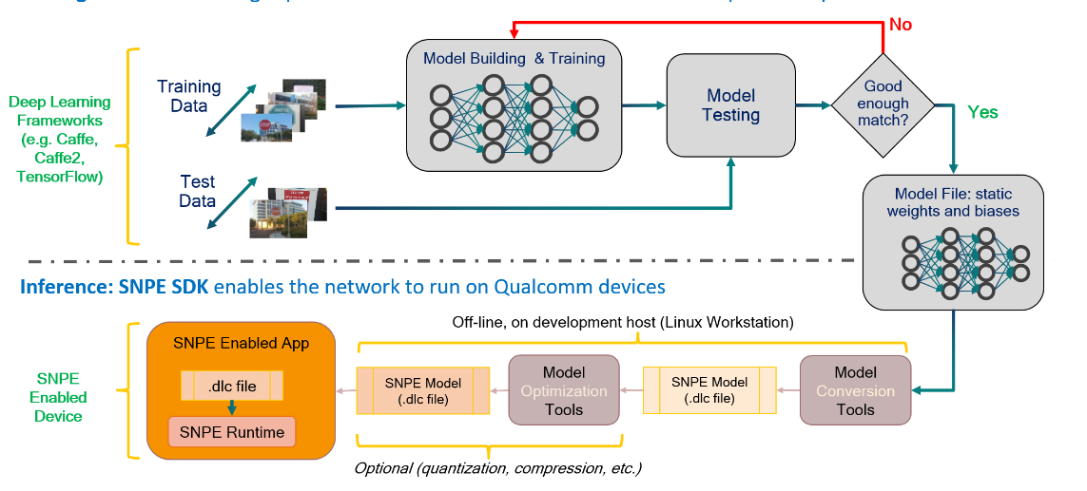

Slide 5


Tech Stack
Tensorflow
OpenCv
Android Studio
Qualcomm SNPE SDK

Slide 6
What have we done till now?
Pre-processed the dataset
Generated an AI algorithm using Tensor-flow library.
Built a CNN for Feature Generation with an accuracy of 96%

Slide 7
What can we do more?
IoT Integration - using hardware like sensors
Multiple inputs to detect the disease with better accuracy
Product(Rolling) version release – To keep the database updated with newer diseases.

